Slide 1
PGST Meeting 5/1
Port Gamble S'Klallam Tribe Energy Analysis and Decarbonization
UW ChemE Capstone Team

Slide 2
Today's Agenda
BAU Propane Data Finalized
Campus-Wide Survey Draft
Final Report Draft
Electric Heating Scenarios
Electric Boiler
ASHP Options
Boiler replacement
Furnace replacement
Next Steps

Slide 3
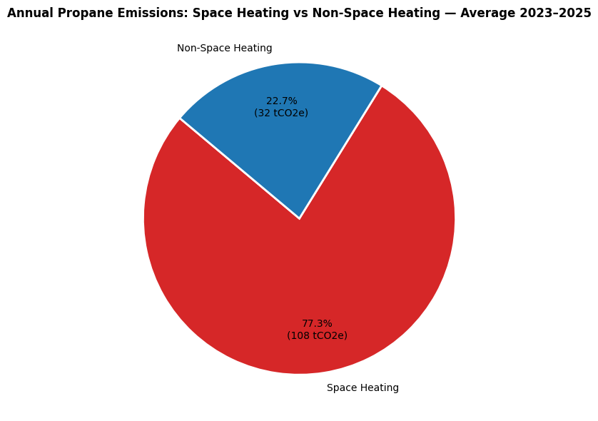
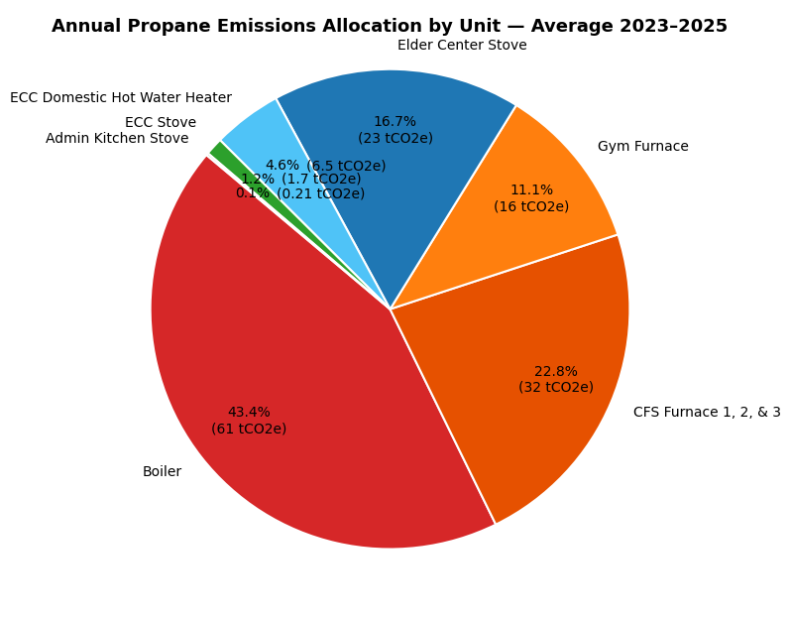
BAU Propane Data Finalized
BAU propane dataset is finalized (hourly, by device). Full methodology and assumptions are detailed in Appendix slides.

Slide 4
Campus-Wide Survey Draft Complete
Solar Information:
Roof areas
Solar capacity
Annual solar potentials
Device Data
Relevant propane powered devices
Annual GHG emissions per device

Slide 5
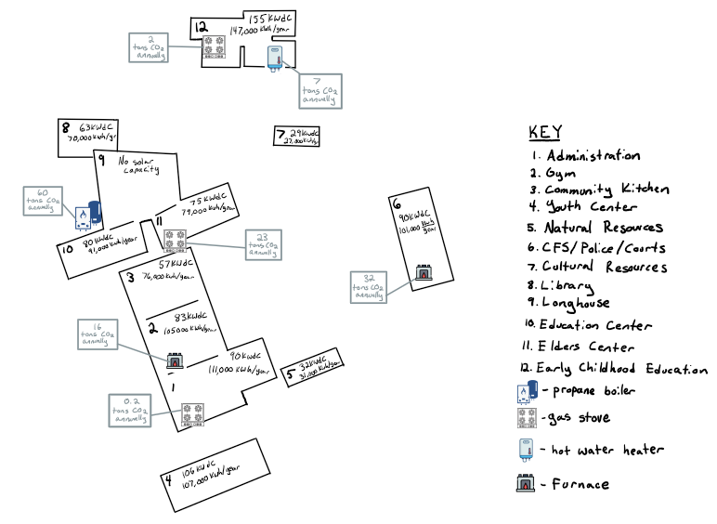
Administrative Complex Site Survey

Slide 6
Final Report Draft
Report structure is finalized across five sections:
Overview of Past Work: summarizes prior analysis
Business as Usual: current electricity and propane consumption, REopt modeling
Proposed Electric Heating Systems: cost and emissions under several electrification scenarios
Solar Implementation: roof-by-roof solar potential and optimal capacity
Grant and Funding Resources: explores funding options
Numbers being finalized — full draft coming soon

Slide 7
Electric Heating Scenarios
Electric Boiler
CAPEX: | ~$13,000 | EIA documentation (165 kW)
 | ~$82,000 | LBNL equation based on rating
OPEX: | ~$41,000/year | REopt, Schedule 25 billing
GHG: | 8 tCO₂e/year | Grid emissions, assuming no PV
(note: PSE has 2045 carbon-free target)
Wide CAPEX range indicative of high supplier variation.
Notes:
Find difference between meter readings - with propane boiler (PSE sch 24) and with the electric boiler (PSE sch 25) to find the increase in electricity costs the year after putting in the boiler
If we want to show electric boiler vs. propane boiler fuel → take fuel costs and compare to electric boiler electricity cost.
Schedule 25 penalizes for peaks and the electric boiler increases the height of peaks.
Need to better understand inputs into REopt and go over the approach more thoroughly
Dollar numbers will be remembered - need to understand everything clearly before presenting it.
CAPEX was better validated - using two credible sources. The message is good: there is a lot of variation in estimates.
Need to explore OPEX better.
Clear explanation and showing work. Explanation goes up into Rachel’s five pages, showing work in the Appendix.

Slide 8
Electric Heating Scenarios
ASHP
Building needs
Longhouse radiative floor heating: 135°F
Ed. Center air-over-water heating: 195°F
The Education Center's high temperature requirement is the key constraint
BAU heating system:
Boiler supplies 195°F water to the Ed. Center and mixes with cooling water to deliver 135°F to the Longhouse.

Slide 9
Electric Heating Scenarios
ASHP: Options
Option A: Full Heat Pump Replacement
High efficiency HP for 135°F
Low efficiency HP for 170°F
Requires HX retrofit (won't reach 195℉ on its own)
Option B: Electric Boiler Hybrid System
No retrofit requirement (Utilizes EB for 170°F → 195°F)
100% propane displaced
Option C: Existing Boiler Hybrid System
No retrofit requirement (Utilizes PB for 170°F → 195°F)
Displaces significant amount of propane

Slide 10
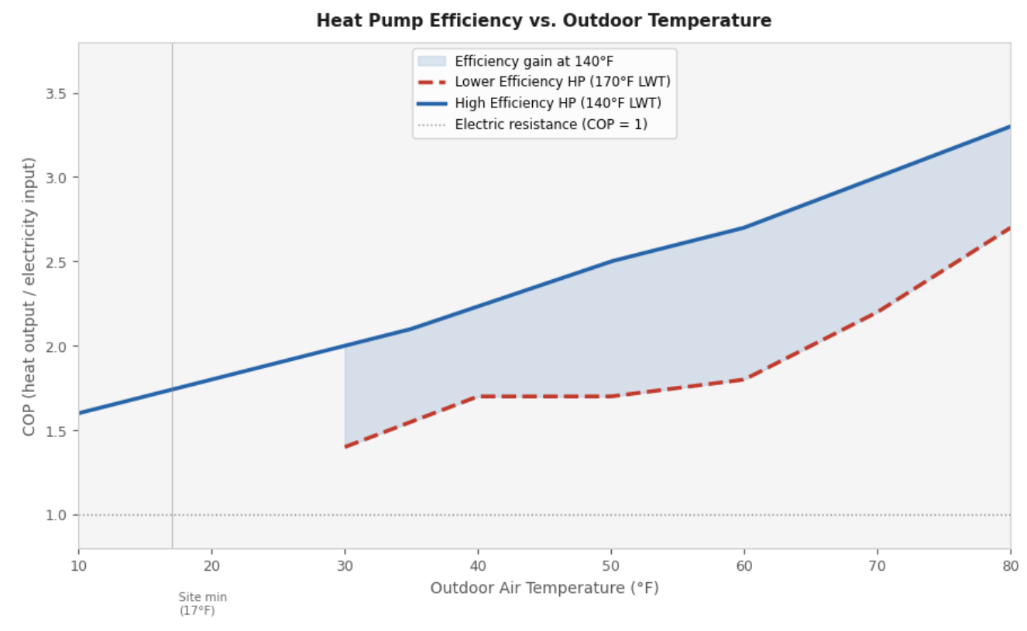
Electric Heating Scenarios
We compared 140°F vs. 170°F leaving water temperature.
Conclusion:
Operating at 140°F LWT yields meaningfully higher COP across all outdoor temperatures
It reduces annual electricity consumption by ~7,500 kWh/yr compared to 170°F LWT.

Slide 11
Electric Heating Scenarios
ASHP Evaluation Framework
Each option compared across three dimensions:
CAPEX — equipment and installation costs
OPEX — annual electricity costs
HP efficiency (COP) is temperature dependent
Electric boiler efficiency constant (ε_{EB}< COP_{HP})
GHG — emissions reductions from propane displacement
Goal: Pro/cons summary of each design option

Slide 12
Next Steps
Finalize electric heating scenarios
Pros/Cons of boiler replacement options
Impacts of Air-to-Air replacement of furnaces
Solar sizing for increased electricity load
Overall project CAPEX summary
Final report delivery

Slide 13
Thank you!

Slide 14
Appendix

Slide 15
Appendix - Full Propane
Disaggregation
Bottom-Up Methodology — ERA5 · Regression · Equipment Modeling
Port Gamble S'Klallam Tribe | Energy Analysis

Slide 16

ERA5 Reanalysis Dataset
Temperature Data Source & Handling
What is ERA5?
Step 1 — Bilinear Interpolation
Grid-cell → site-point
ERA5 native 0.25° cells (~28 km) don't match the site exactly.
Interpolation done with bilinear weighting on the four surrounding cells.
Site: lat 47.852°, lon 237.431° (ERA5 0–360° convention).
ERA5 is ECMWF's fifth-generation atmospheric reanalysis — a global hourly gridded climate dataset that blends historical observations with a physics-based model. Grid resolution: 0.25° (~28 km) Variable used: 2 m air temperature (t2m) Record period: 2015–2026 (hourly) Format: GRIB2 (ERA5 download) Parser: cfgrib / xarray
Step 2 — Unit Conversion
Kelvin → °F: (K − 273.15) × 9/5 + 32
Step 3 — Daily Summary
Collected T_{avg}, T_{min}, and T_{max} for each day
Outputs: 2015-2026 Hourly and Daily Temperature CSVs

Slide 17


Delivery Data Cleaning
Propane Transaction Records — Ferrell Gas 2005–2025
Raw transaction records include deliveries, credits, and returns. Two cleaning rules are applied before the delivery file is used downstream.
Assumption 1 — Remove Return Deliveries
Assumption 2 — Minimum Delivery Size
Negative-gallon transactions represent returned/credited deliveries. Rule: For each negative entry, search for a positive entry with exactly matching gallons within ±30 days. Drop both. Rationale: These are accounting corrections, not actual fuel deliveries, and would double-count if retained.
Small deliveries likely represent alternate propane tank fills under the same account. Rule: Drop all deliveries under 200 gallons. Rationale: Routine deliveries serving the campus buildings are always bulk fills. Sub-200 gal records are not representative of steady-state consumption.
Output: Propane Deliveries 2005–2025.csv — used directly by regression (Notebook 3) and the disaggregation model (Notebook 4). Monthly aggregation logic is intentionally excluded from downstream use.

Slide 18
Delivery-Window Regression
Fitting Propane Use vs. Temperature
Building Delivery Windows
Key Parameters & Outputs
Each delivery is the end of a consumption window beginning
at the prior delivery date. Window length = days between
deliveries. Gallons ÷ days = gal/day for that window.
Interval-average temperature is computed from daily ERA5 data.
Window
2023–2025
Balance Point Tb
60 °F
Piecewise Linear Model
Design Min
20 °F
Below Tb (60°F): gal/day = m × T + b [heating regime]
Above Tb (60°F): gal/day = baseline_gpd [base loads only]
Baseline is the mean of all windows with T ≥ Tb.
Tb sweep: 50–71°F tested; 60°F selected.
Outliers Removed
2
Outputs
m (slope), b (intercept), baseline_gpd
Outlier Removal
Metrics
R²_heat, R²_baseline
After first fit, the 2 windows with largest absolute residual
are dropped. Model is refit on the cleaned set.
A4

Slide 19
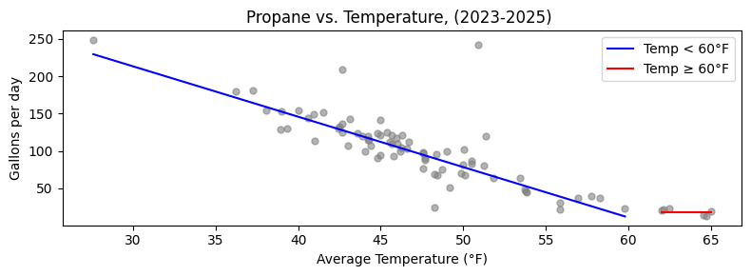

m=-6.742649, b=415.5719, baseline=18.6820 (gal/day)
R² = 0.842

Slide 20
Linear Duty Cycle Method
Translating Outdoor Temperature → Hourly Propane Demand
Duty Cycle Formula
Duty Cycle at Key Temperatures
DC = (T_{b} − T_{outdoor}) / (T_{b} − T_{design_min})
Tb = 60°F (balance point)
T_{design_min} = 20°F (design winter minimum)
DC is clipped to [0.0, 1.0].
T = 20°F (design min)
DC = 1.0 → Full rated input
T = 40°F (cold day)
DC = 0.5 → Half rated input
Engineering Storytelling
T = 60°F (balance pt)
DC = 0.0 → No heating needed
The design minimum of 20°F reflects equipment sizing: the heating systems are designed to maintain comfortable indoor temperatures down to this outdoor threshold. Over the 2023–2025 period, temperatures fell below 20°F on only one day (1/13/2024), reaching a minimum of 16.8°F.
T = 75°F (summer)
DC = 0.0 → Clipped to zero
Hourly BTU/hr = Rated Input (BTU/hr) × Duty Cycle × Scale Factor
Scale factor calibrates unscaled model output to match top-down delivery-window targets.

Slide 21
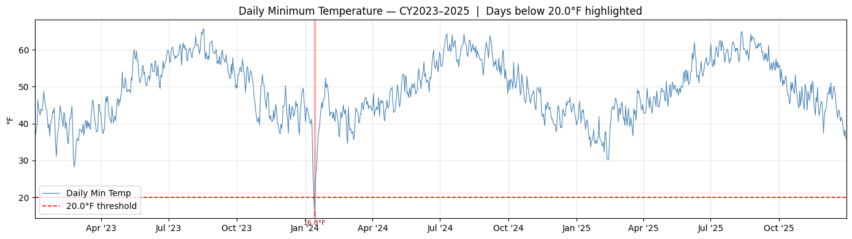

Slide 22
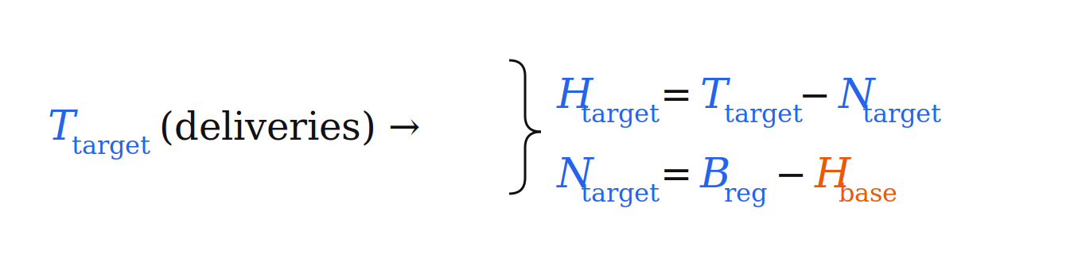
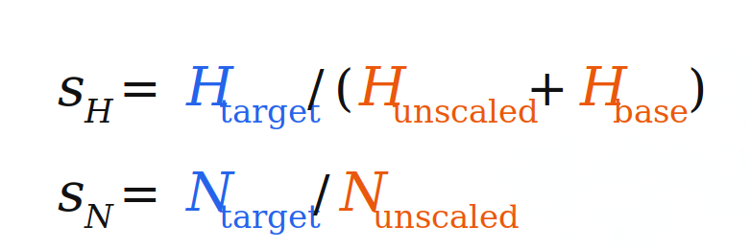
Annual Scaling to Top-Down Targets
First, use regression/heating baseline to split total propane into heating and non-heating
Heating Scale Factor
Regression baseline B_{reg} accounts for all non-weather sensitive use
H_{base} is an assumed heating baseline from the boiler that is non-weather sensitive
Scale factors: (Top-down regression divided by bottom-up accounting)
Year | Heating Scale | Non-Heating Scale
2023 | 1.2683 | 1.0793
2024 | 1.1769 | 1.0434
2025 | 1.2254 | 1.0636
Scale factors near 1.0 indicate a well-fitted bottom-up model.

Slide 23
Rated-Capacity Cap & Redistribution
Preventing Physically Impossible Load Exceedances
After scaling, individual hourly loads may exceed a unit's rated input capacity. Excess energy is capped and redistributed within the same unit across hours where headroom exists.
Step 1 — Cap at Rated Input
Step 2 — Redistribute Excess
1) Clip any hour that exceeds rated_input_btu_hr back down to the nameplate max
2) Tally up the total excess Btu that got removed
The excess Btu removed by the cap are spread back across all hours of that unit, proportional to how much headroom each hour has below the nameplate max.
In practice this can bleed a small amount of load into low-demand hours (like summer), since those hours have the most headroom.
Example
Before (unclipped)
After (clipped + redistributed)
Hour 1: 420,000 BTU/hr ← exceeds 378,000 rated cap
Hour 2: 310,000 BTU/hr
Hour 3: 295,000 BTU/hr
→
Hour 1: 378,000 BTU/hr (clipped; 42,000 excess)
Hour 2: 310,000 + 24,500 = 334,500 BTU/hr
Hour 3: 295,000 + 17,500 = 312,500 BTU/hr

Slide 24
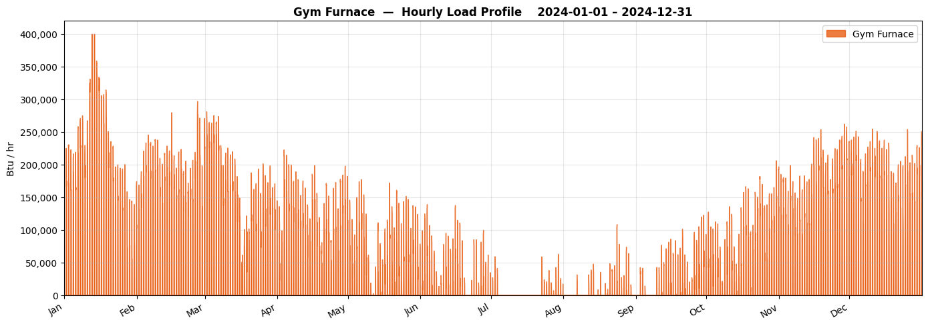
Rated: 400,000 BTU/hr input

Slide 25
Boiler — Primary Space Heating
HEATING
unit_1 · Heating Equipment
Scheduling
Equipment Specs
Model Parameters
Days: All 7 days
24/7 heating
Rated: 378,000 BTU/hr input
314,000 BTU/hr output (83.1% efficiency)
Thermostat-fighting override: boiler subject to hysteresis shutoff.
Baseline fighting load (+30% duty-cycle floor) applied to this unit only.
Engineering Story
The boiler is the dominant propane consumer. The 30% DC floor captures controls hysteresis (AC vs. boiler fighting) that persists even in mild weather.

Slide 26
Thermostat Fighting & Boiler Hysteresis
Operational Reality — Boiler Cycling by Facilities Staff
The Problem
State Machine Logic
During mild weather, the boiler and AC system fight each other — the boiler heats while AC cools. Facilities staff intervene manually, cycling the boiler off when it is locally too hot, and back on when it gets cold again.
BOILER ON
BOILER OFF
T > 60°F
for 12 hrs →
← T < 54°F
for 12 hrs
Hysteresis State Machine Parameters
Shutoff threshold: 60°F (BOILER_SHUTOFF_TEMP_F)
Restart threshold: 54°F (BOILER_RESTART_TEMP_F)
Shutoff delay: 12 hrs above threshold before staff acts
Restart delay: 12 hrs below threshold before restoration
State: boiler_on = True → False (shutoff) → True (restart)
When BOILER OFF:
• Weather-driven BTU/hr = 0
• Baseline-fighting load = 0
• Both go to zero — no propane
consumed during shutoff window

Slide 27
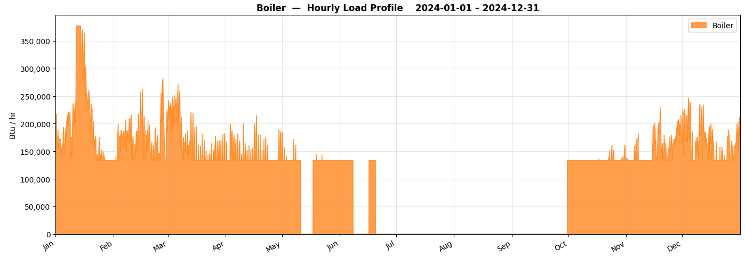

Slide 28
CFS Furnaces 1, 2 & 3
HEATING
unit_3 · Heating Equipment
Scheduling
Equipment Specs
Model Parameters
Days: All 7 days
24/7 heating
Rated: 222,000 BTU/hr input (3 × 74,000 BTU/hr)
177,600 BTU/hr output (80% efficiency)
Three identical 74,000 BTU/hr furnaces modeled as a single aggregate unit.
No thermostat-fighting override or baseline floor applied to this unit.
Engineering Story
CFS furnaces operates similarly to the boiler, but with no baseline floor as assumed to be no thermostat fighting.The three-unit aggregate simplifies the model without meaningful loss of accuracy.

Slide 29
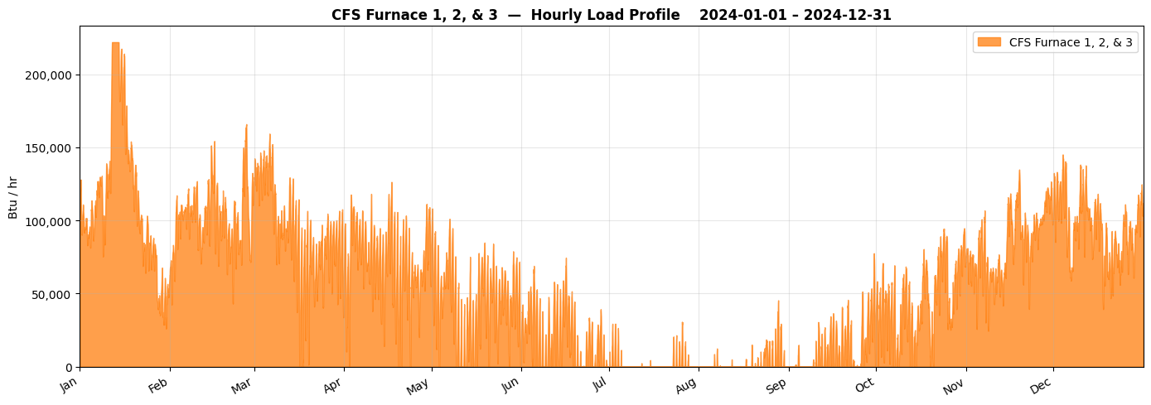

Slide 30
Gym Furnace — Cold-Soak Recovery
HEATING
unit_2 · Heating Equipment
Scheduling
Equipment Specs
Model Parameters
Days: All 7 days
3:00 PM – 9:00 PM (occupied only)
No setback heat (setback_temp_f = 0°F → DC = 0 when unoccupied)
Rated: 400,000 BTU/hr input
324,000 BTU/hr output (81% efficiency)
Cold-soak recovery: first 3 hours of each occupied block use 70°F balance point instead of 60°F.
No thermostat-fighting override or baseline floor applied to this unit.
Gym balance point is 70°F to represent cold-soak recovery
Cold-soak recovery period lasts 3 hours from first occupied hour each session.
Engineering Story
The gym sits unoccupied all morning; the building cools toward outdoor temperature. When staff arrive at 3 PM the furnace must overcome both the steady-state heat loss AND re-heat the thermal mass — modeled as a higher effective balance point during the first 3 hours of each occupied block.

Slide 31
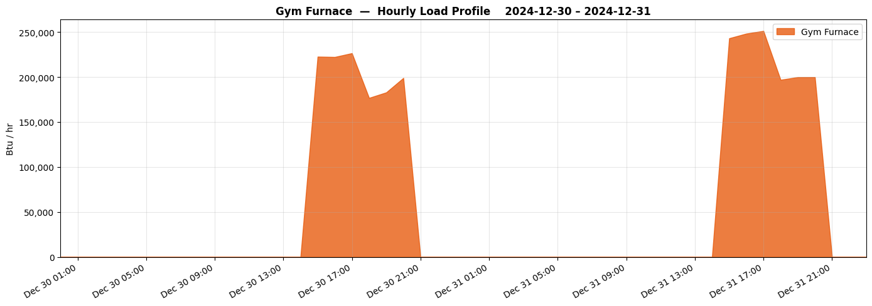

Slide 32
Elder Center Stove
NON-HEATING
Non-Heating Equipment
Scheduling
Equipment Specs
Model Parameters
Days: All 7 days
7:00 AM – 9:00 AM (breakfast prep)
11:00 AM – 1:00 PM (lunch service)
Imperial IR-6-RG24 Commercial Stove
Rated: 302,000 BTU/hr input
Utilization = 80% — high-throughput community kitchen.
Largest non-heating propane consumer by rated capacity.
Elder Center operates 7 days/week with full food service for breakfast and lunch.
80% utilization is consistent with observed community meal service volumes.
Engineering Story
The Elder Center serves hot meals 7 days a week, making it the only non-heating propane load that runs on weekends. Its 302,000 BTU/hr commercial range is the largest single non-heating appliance — the breakfast + lunch dual window structure captures the actual meal-service rhythm.

Slide 33
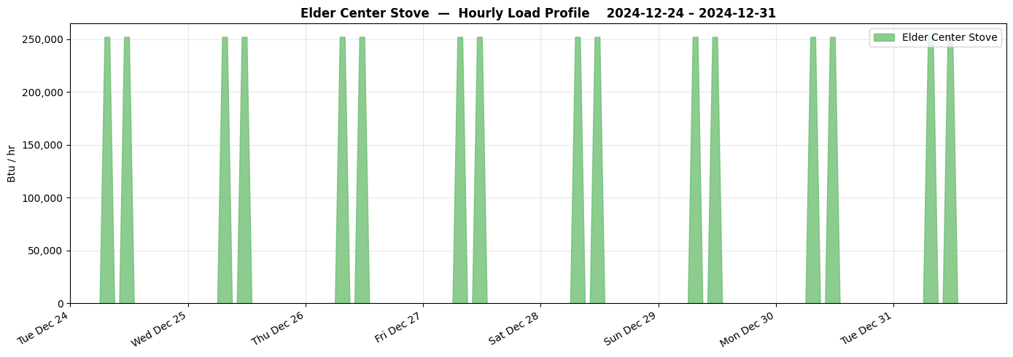

Slide 34
ECC Domestic Hot Water Heater
NON-HEATING
Non-Heating Equipment
Scheduling
Equipment Specs
Model Parameters
Days: Weekdays (Mon–Fri)
5 one-hour windows: 8–9 AM, 10–11 AM, 12–1 PM, 2–3 PM, 4–5 PM
Showering, cooking, dishwashing, etc.
Assumed: 75,000 BTU/hr input
Utilization = 100% — assumed full-fire during each window.
Load is temperature-independent; classified as non-heating.
Then scaled using non-heating scaling factor for each year
A3
A4
Engineering Story
Hot water demand is independent of outdoor temperature. The five one-hour windows were chosen to represent off and on peaks due to showering, cooking, and washing dishes, rather than a continuous burn.

Slide 35
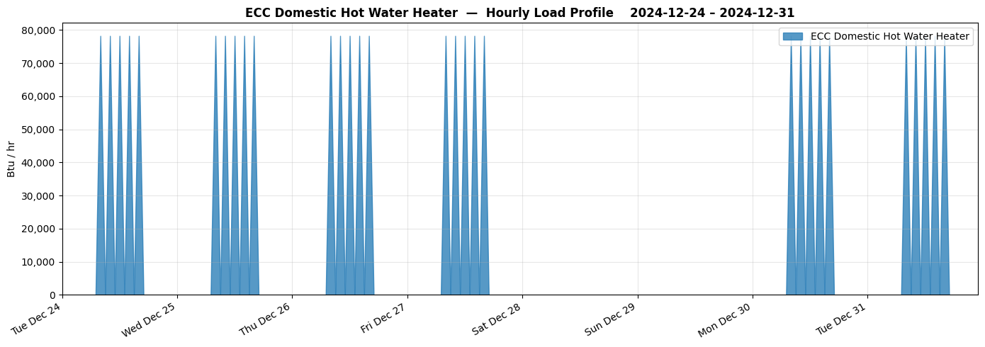

Slide 36
ECC Kitchen Stove
NON-HEATING
Non-Heating Equipment
Scheduling
Equipment Specs
Model Parameters
Days: Weekdays (Mon–Fri)
11:00 AM – 1:00 PM (lunch service, 2-hour window)
Assumed: 60,000 BTU/hr input
Utilization = 80% — not all burners on simultaneously during every lunch.
80% burner utilization during lunch service is a reasonable average for an institutional kitchen.
Engineering Story
The ECC stove operates primarily during the lunch service window. An 80% utilization factor accounts for the reality that not all burners are running simultaneously at every meal — typical of batch cooking for variable crowd sizes.

Slide 37
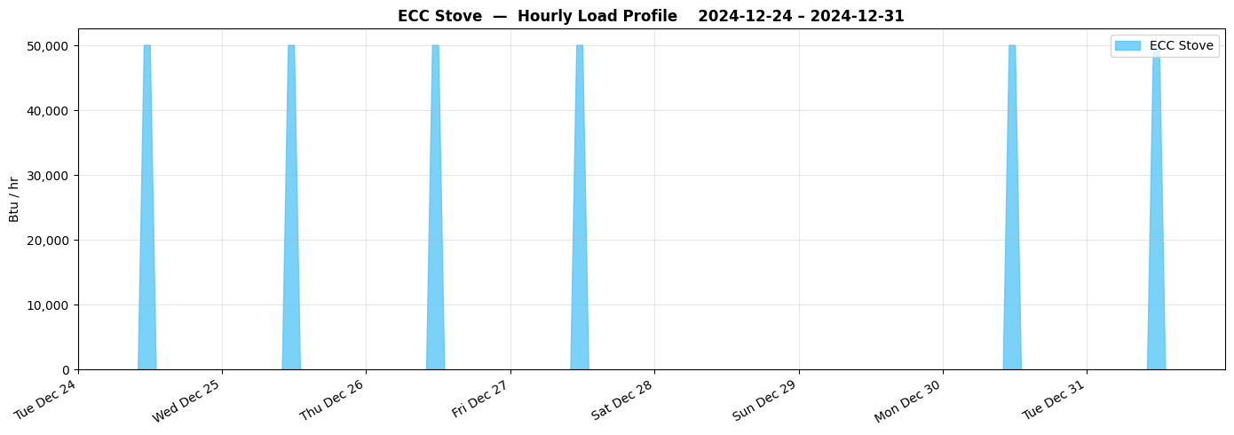

Slide 38
Admin Building Kitchen Stove
NON-HEATING
Non-Heating Equipment
Scheduling
Equipment Specs
Model Parameters
Days: Weekdays (Mon–Fri)
11:00 AM – 12:00 PM (one-hour window)
Assumed: 60,000 BTU/hr input
Utilization = 20% — lightly used; staff heating occasional meals.
Very small contribution to total propane budget.
20% utilization reflects a staff break-room stove used sporadically, not a full kitchen operation.
Engineering Story
The admin kitchen is a break-room-style kitchen, not a full food service operation. The 20% utilization factor captures occasional use — staff reheating lunches, occasional small cooking tasks — during a 1-hour daily window.

Slide 39
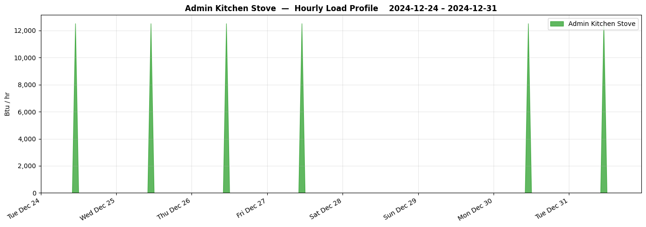

Slide 40
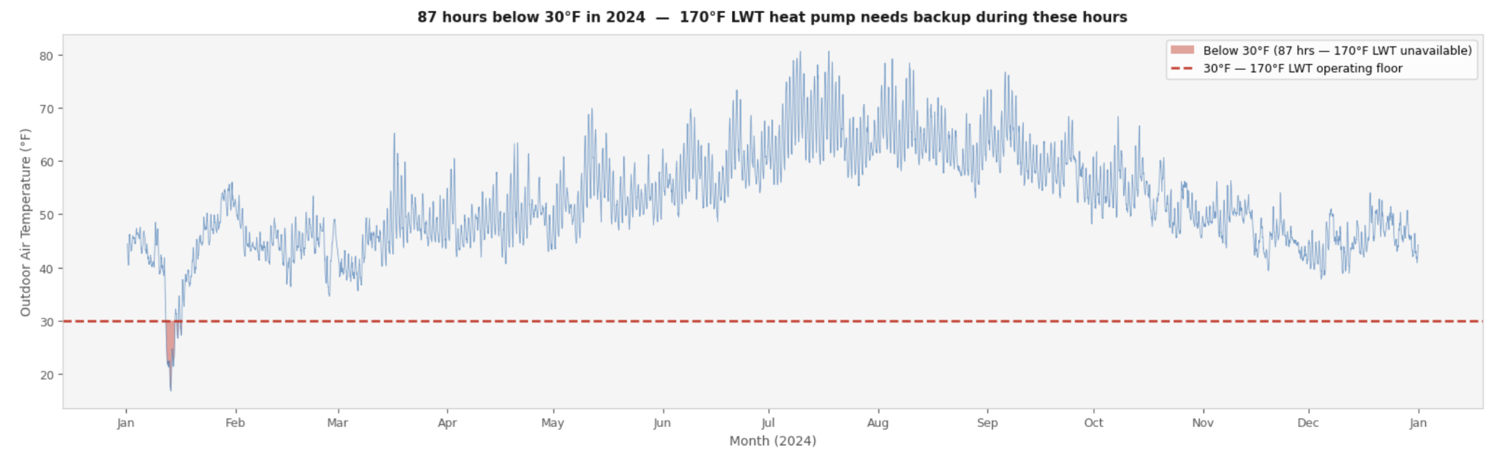
Electric Heating Scenarios
ASHP: Options

